Slide 1
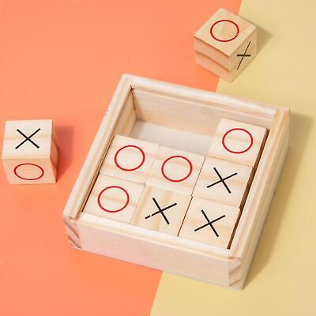
TIC TAC TOE

Slide 2
INTRODUCTION:
Tic Tac Toe, also referred to as "Noughts and Crosses," is a time-honored game with ancient roots, cherished by players in various corners of the world.
Its rules are straightforward and widely familiar.
Engaging in this pen-and-paper duel, two players, denoted as X and O, take turns marking squares within a 3x3 grid.
Victory is clinched by skillfully aligning three of one's marks either horizontally, vertically, or diagonally.
Each player can place just one symbol per turn, gracefully passing the play to their adversary.

Slide 3
Game Strategy:
Winning Strategy:
Both players strive to arrange three symbols in adjacent cells, either horizontally, vertically, or diagonally, with the first to achieve this alignment declared the winner. Player 2 aims to disrupt Player 1's progress by strategically placing their own symbols between Player 1's.
Losing Scenario:
If your opponent successfully achieves the required symbol alignment before you, you lose the game.
Draw Outcome:
In the event that neither player manages to achieve the necessary alignment, and all nine grid cells are marked, the game ends in a draw or tie. In this case, neither player earns a point. This occurrence is common during the game and adds an element of excitement to the gameplay.

Slide 4
Java Programming for Customized Tic Tac Toe Gameplay
Tic-tac-toe serves as an excellent educational tool, imparting logic and sportsmanship to young learners through its inherent simplicity.
A customizable n x n variant of the classic 3 x 3 tic-tac-toe game can be designed, allowing players to take turns placing their symbols on an n × n board with the goal of aligning d of their symbols either vertically, horizontally, or diagonally.
In this project, I utilized Java programming to craft a console version of Tic Tac Toe.
The foundational concept revolves around effectively managing the game board using a two-dimensional array or grid. Each cell in this array holds a value indicating whether it is vacant, or occupied by an X or an O.

Slide 5
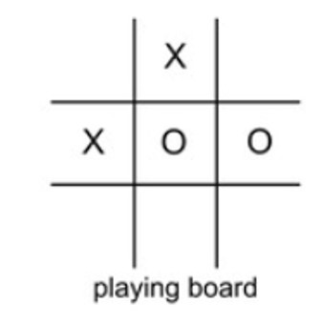
Consider a 3 x 3 board so the player board will look like the image below.
TIC TAC TOE BOARD

Slide 6
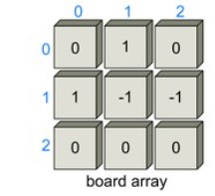
The board array will take on a structure similar to the image provided below.
Two-Dimensional board array
The center row of the 3 x 3 matrix board has the cells board[1][0], board[1][1], and board[1][2], where the first number represents the row number and the second number represents the column number of the board.

Slide 7
The specific considerations for the Tic Tac Toe game implemented in Java:
The program displays a 3x3 board using dashes to represent empty spaces.
After each turn, the board is updated with 'x' or 'o' in the chosen position. This is done by prompting either player 1 or player 2 to input row and column indices.
If a player selects a position that is outside the board or already occupied, the program notifies them and prompts for a valid input.
Upon achieving three symbols consecutively in a row, column, or diagonal, the program declares the respective player (1 or 2) as the winner and displays the final board.

Slide 8
General implementation order
Dashes should be placed on a Tic Tac Toe board.
Create a function that squares up the board.
The player’s turn and the symbol they are using should be noted.
Ask for a row and a col repeatedly until they are appropriate.
Set the appropriate symbol in the relevant place on the board.
Make a function that determines who won the game.
Test to see if there was a tie in the game.
To keep the game alive, use a loop.

Slide 9
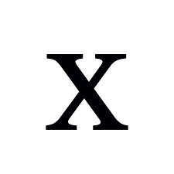


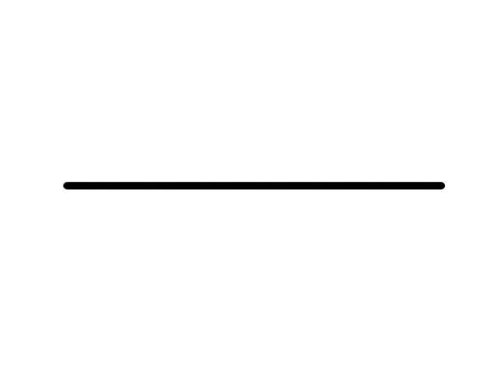
Player 1 wins !

Slide 10
CONCLUSION
In essence, Tic Tac Toe is a timeless gem in the world of games.
Its elegant simplicity belies a depth of strategic thinking that can captivate players of all levels.
The balance of power ensures that draws are common, underscoring the importance of foresight and skill.
While it may seem straightforward, true mastery demands the ability to anticipate moves and plan ahead.
Ultimately, Tic Tac Toe stands as a testament to the enduring appeal of games that blend accessibility with a satisfying intellectual challenge.

